Slide 1
Senior Design Functional Demonstration Group 3(D POV)
Philip Geramian, Alex Julian, Lyle Moffit, Roman Olesh
Syracuse University College of Engineering and Computer Science
December 2, 2014

Slide 2
3D POV - The Goal
Three Dimensional Persistence of Vision Display

Slide 3
3D POV – Proof of Concept
Two Dimensional Persistence of Vision Display

Slide 4
3D POV - Requirements
 | Quality Display | Quiet System | Safe System | Data Communication | Professional Enclosure | Overall Score
Quality Display | - | 0.50 | 0.00 | 0.50 | 1.00 | 2
Quiet System | 0.50 | - | 0.00 | 0.00 | 1.00 | 1.5
Safe System | 1.00 | 1.00 | - | 1.00 | 1.00 | 4
Data Communication | 0.50 | 1.00 | 0.00 | - | 1.00 | 2.5
Professional Enclosure | 0.00 | 0.00 | 0.00 | 0.00 | - | 0

Slide 5
3D POV - Block Diagram

Slide 6
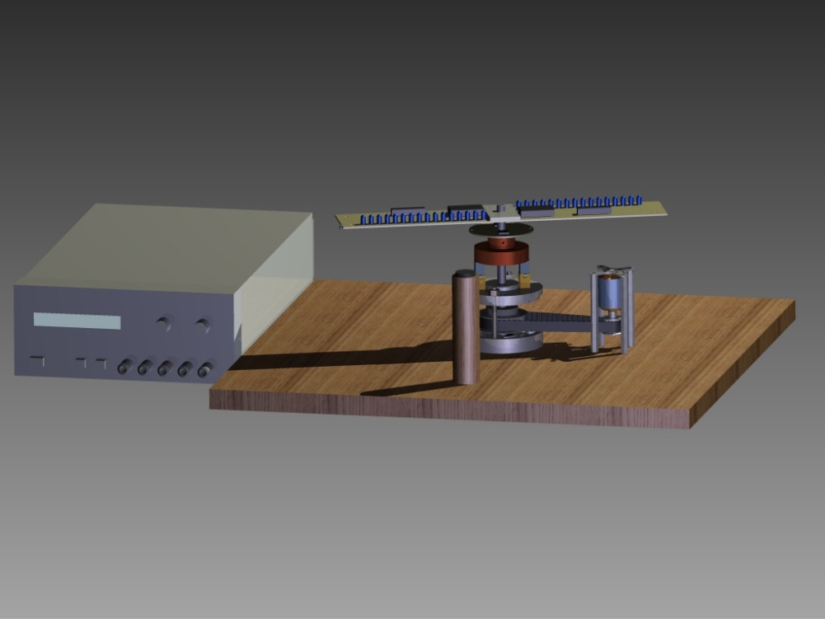
3D POV – Proof of Concept 3D Model

Slide 7
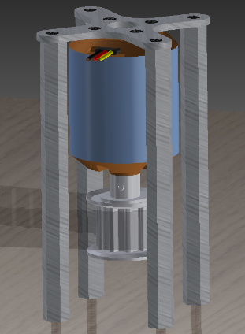
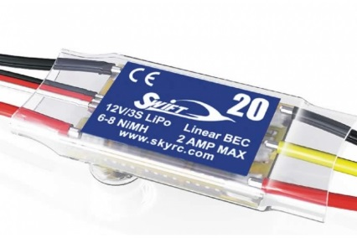
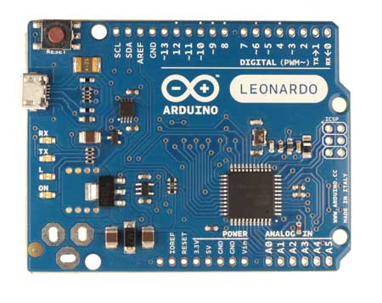
3D POV – Drive system
Figure: From left to right (a) 3D rendering of the Turnigy d2836/11 750 kV DC Brushless motor, (b) Swift 20A ESC ^{[1]}, and (c) Arduino Leonardo^{[2]}

Slide 8
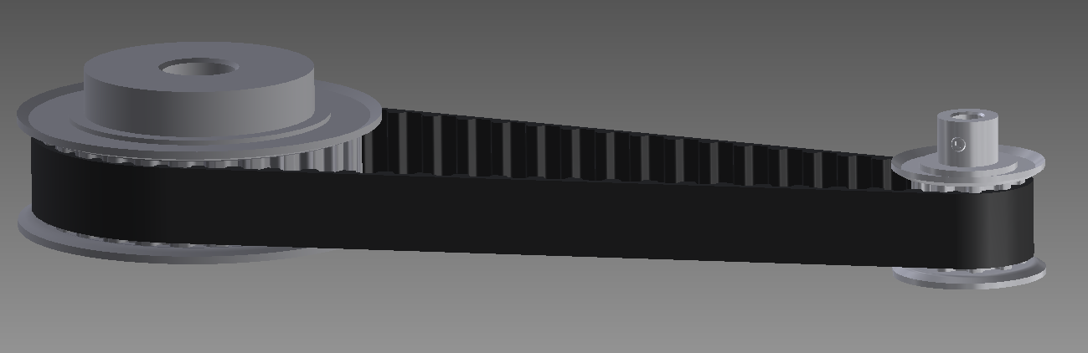
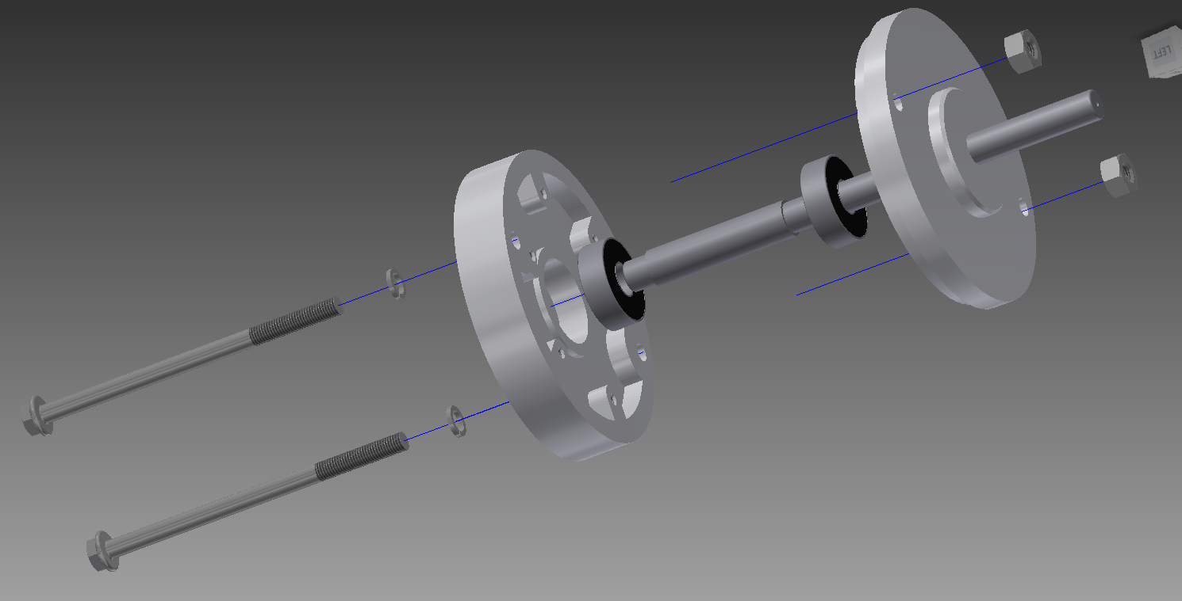
3D POV – Mechanical Assembly

Slide 9
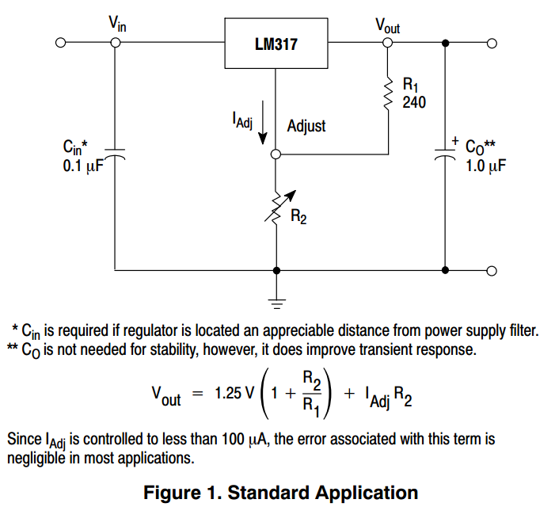
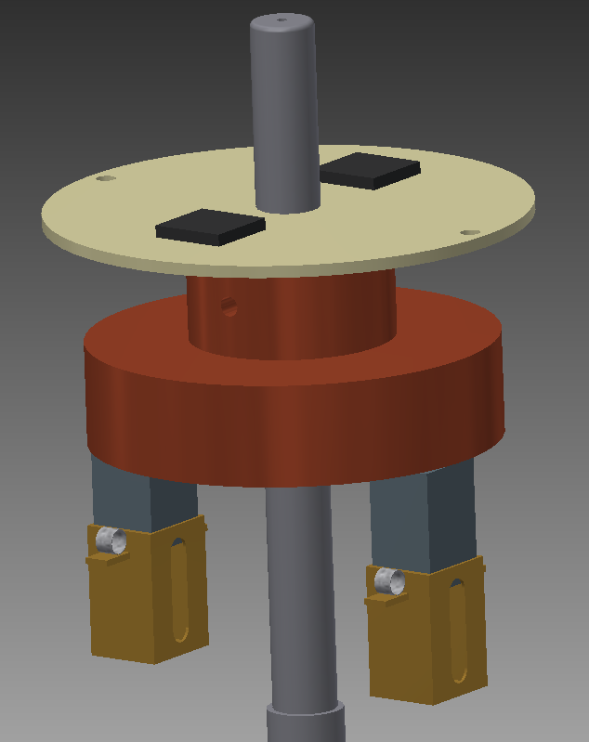
3D POV – Power Electronics
[3]

Slide 10
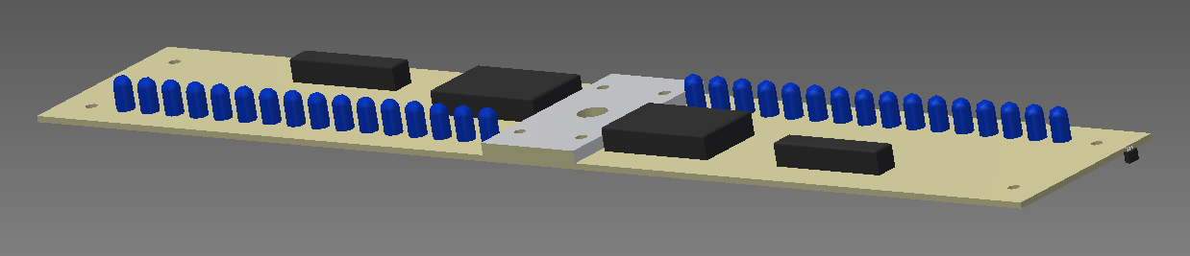
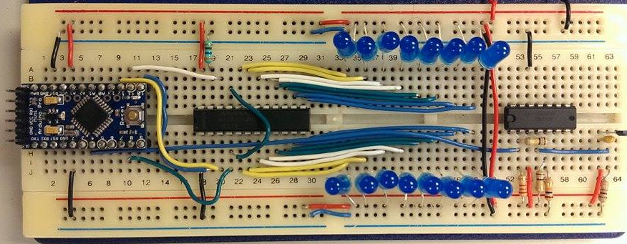
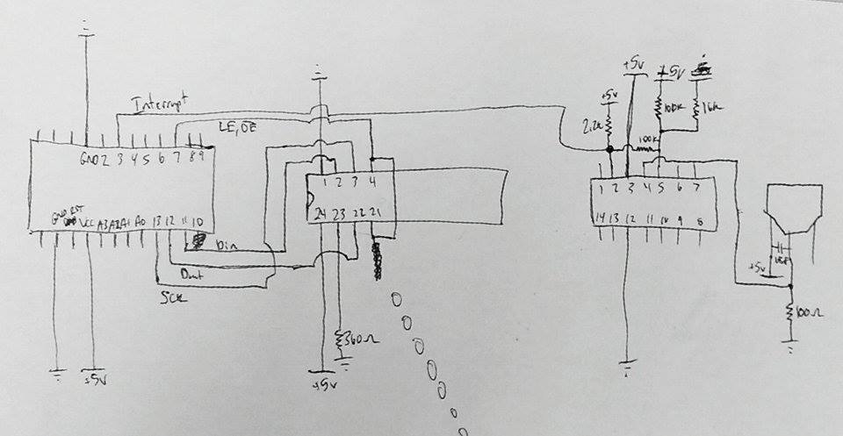
3D POV – Spinning Electronics

Slide 11
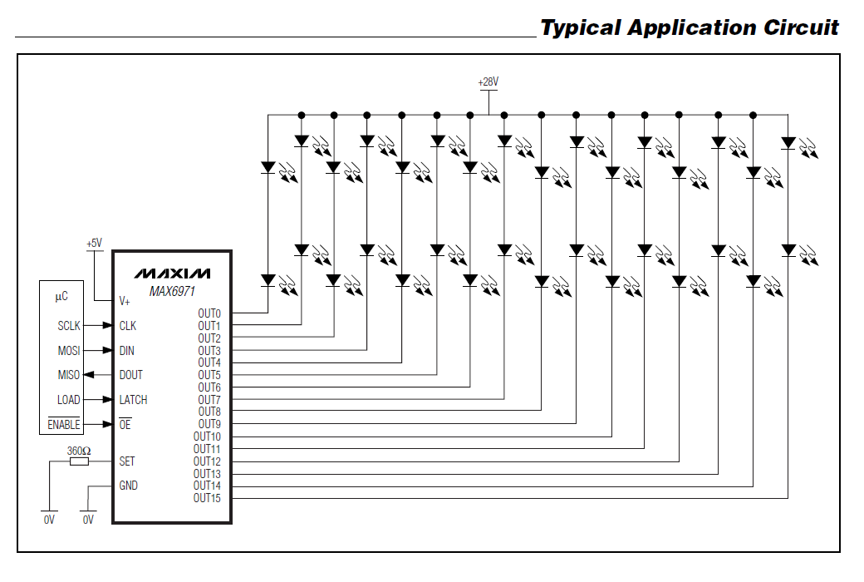
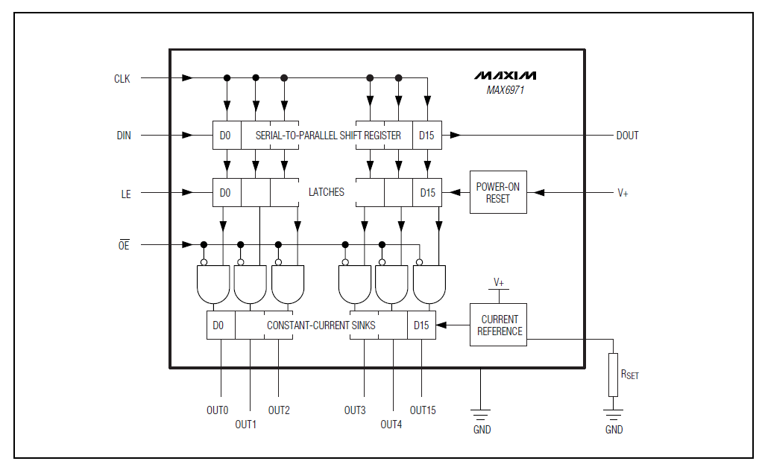
3D POV – MAX6971 LED Driver
[4]
[4]

Slide 12
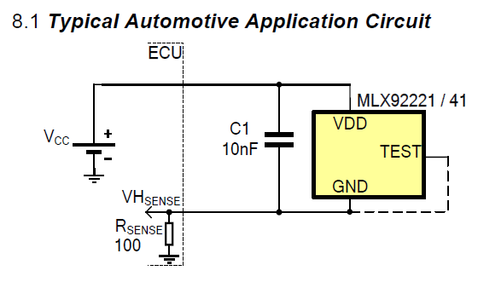
3D POV – Hall Effect Sensor
[5]

Slide 13
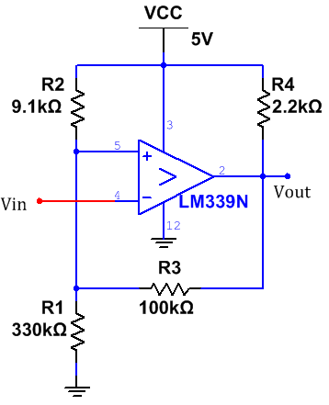
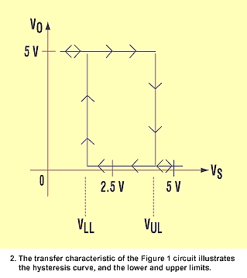
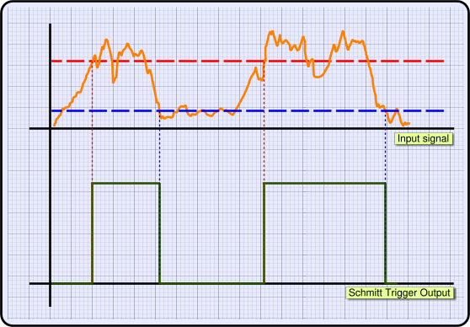
3D POV – Schmitt Trigger
[7]
[6]

Slide 14
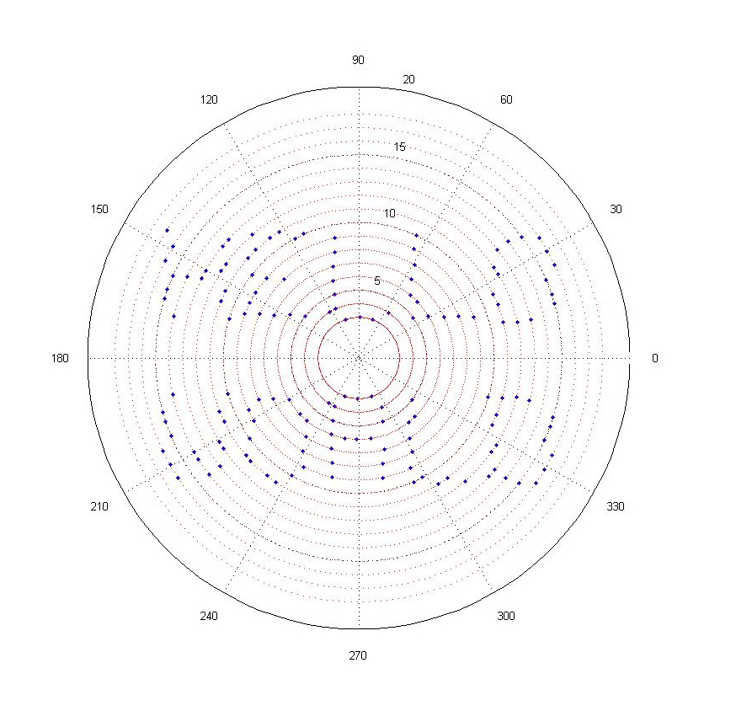
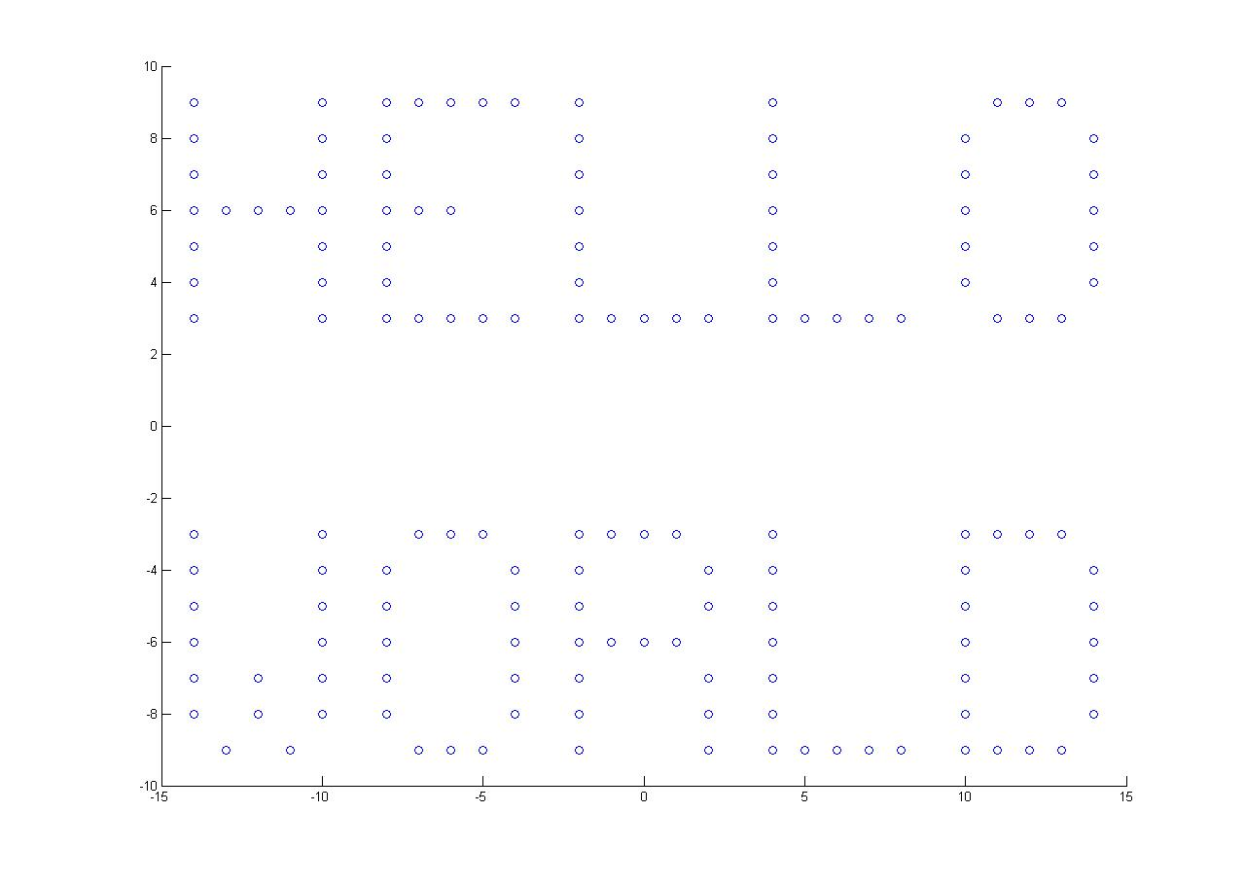
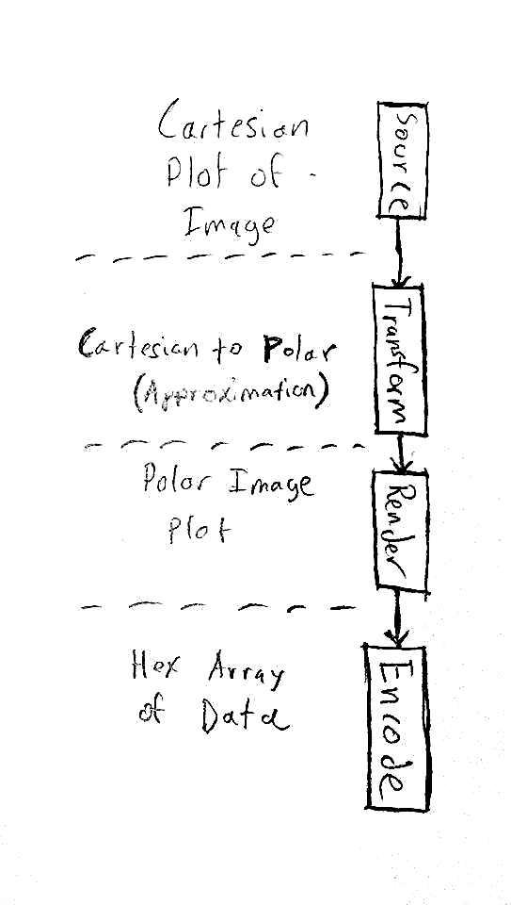
3D POV – Software [MATLAB]

Slide 15
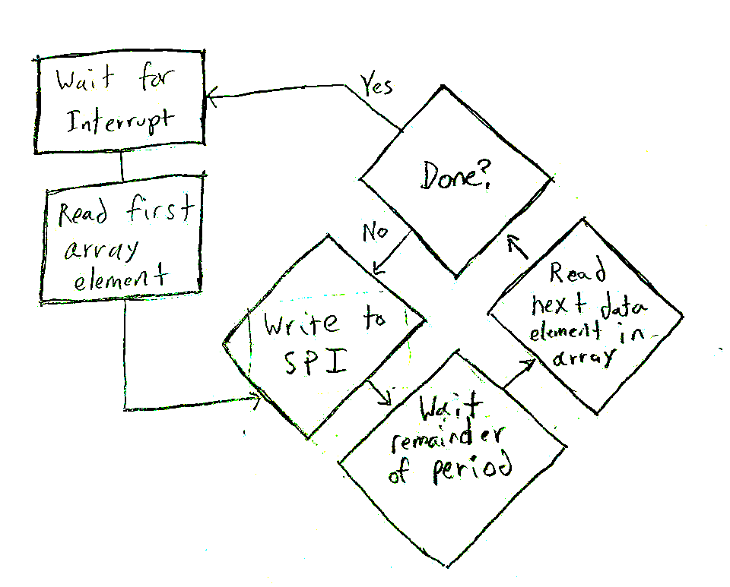
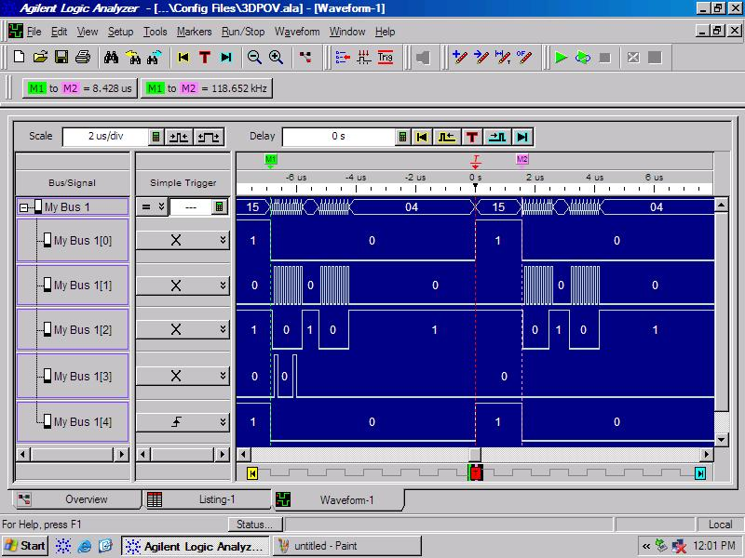
3D POV – Software [Arduino Pro Mini]

Slide 16
DEMONSTRATION

Slide 17
3D POV – Improvements, The Road Ahead
Higher Amperage ESC
Lay out custom printed circuit boards
Multiple layers for 3D
Incorporate wireless functionality, Improve Data Path
Refine mechanical system
Plexiglas enclosure
More LEDs per blade

Slide 18
Questions?

Slide 19
References
[1] - http://www.skyrc.com/image/cache/data/proshow/ES20-720x480.jpg
[2] - http://arduino.cc/en/uploads/Main/LeonardoNoHeadersFront_2_450px.jpg
[3] - http://www.onsemi.com/pub/Collateral/LM317-D.PDF
[4] – http://datasheets.maximintegrated.com/en/ds/MAX6971.pdf
[5] - http://www.melexis.com/Asset/MLX92241_Fam_Datasheet-DownloadLink-6322.aspx
[6] – www.pcbheaven.com/wikipages/The_Schmitt_Trigger/?p=1
[7] - electronicdesign.com/site-files/electronicdesign.com/ files/archive/electronicdesign.com/files/29/1635/ figure_02.gif

